Slide 1

Dynamic Public Parking Pricing System Based on Real-Time Demand Prediction
CSA0925-PROGRAMING WITH JAVA
Research Scholar
D. Chand basha(192424218)
Ganeshram. M(192321060)
Monish. S(192311132)
Saveetha School of Engineering
Supervisor
Dr. Sivasankar C
Dept of CSE
Saveetha School of Engineering

Slide 2






Project Overview
Application Domain
Project Summary
Smart-city transportation and intelligent public parking management using AI- and data-driven urban mobility techniques.
A system that predicts real-time parking demand and dynamically adjusts hourly parking prices to balance occupancy across zones.
Target Users
Overall Purpose
Private vehicle owners searching for parking, and parking facility operators managing pricing and availability.
Reduce parking search time and traffic congestion while improving space utilization and revenue for city authorities.

Slide 3
Problem Statement
Problem Definition
Develop a system that predicts real-time parking demand and dynamically adjusts parking prices to optimize parking utilization and reduce urban congestion.
Evidence / Statistics
Drivers spend 15–30% of urban travel time searching for parking.
Fixed pricing often leads to overcrowded parking facilities during peak hours.
Limitations of Current Systems
Static pricing does not adapt to changing demand.
Inefficient allocation of parking spaces.
Limited support for smart city parking management.
Expected Impact
Reduced traffic congestion and parking search time.
Increased parking revenue and support for sustainable smart cities

Slide 4




Motivation & Need
Traffic Congestion
Drivers circling in search of parking add avoidable congestion to already busy city streets.
Industry Relevance
Smart-city and intelligent transportation initiatives increasingly rely on real-time, demand-responsive infrastructure.
Social Relevance
Fairer, transparent pricing improves the experience for commuters and supports local business access.
Why Dynamic Pricing
Adjusting price to real-time demand actively redistributes vehicles toward underused parking capacity.

Slide 5
Existing System / Current Practice
Traditional Fixed-Price Parking
Limitations of Static Pricing
Parking fees are set once and remain constant regardless of occupancy or time of day.
Facility operators manually review and revise tariffs, typically on a monthly or seasonal basis.
No mechanism links live occupancy data to the price a driver is charged.
Cannot adapt to sudden demand spikes from events, weather, or peak commuting hours.
Leads to uneven utilization — some lots overflow while others remain underused.
Provides no real-time visibility for drivers into availability or price before arrival.
Limited integration with broader smart-city traffic management systems.

Slide 6

Research / Knowledge Gap
Identified Gap
Most deployed parking systems monitor occupancy but stop short of linking it to real-time, demand-based pricing.
Existing prediction research (see Literature Review) targets forecasting accuracy in isolation, without a connected pricing-and-notification pipeline.
Opportunity for Improvement
Combine live occupancy sensing, short-term demand prediction, and automated tariff adjustment into a single, end-to-end system.
Close the loop by notifying drivers of price and availability before they arrive, rather than after the fact.
The Gap in One Line
“Demand prediction” and “dynamic pricing” exist separately in prior work — rarely as one connected, real-time system.

Slide 7




Proposed Solution
Dynamic Public Parking Pricing System
An end-to-end platform that senses live occupancy, predicts short-term demand, and recalculates parking price automatically.
How It Closes the Gap
Links prediction directly to a pricing engine, instead of treating them as separate research problems.
Pushes price and availability to drivers before arrival through the notification module.
Real-Time Data
Demand
Prediction
Dynamic
Pricing
User
Notification
Parking
Booking

Slide 8
Project Objectives
Primary Goal: To develop a Dynamic Public Parking Pricing System that predicts real-time parking demand and dynamically adjusts parking prices.
1
2
3
Objective 1
Objective 2
Objective 3
[e.g., Achieve ≥90% demand prediction accuracy using historical and real-time occupancy data]
[e.g., Reduce average parking search time by ≥25% within the target zone]
[e.g., Deploy a responsive user notification system with latency under 5 seconds]
Scope: The project focuses on implementing a dynamic parking pricing system that uses real-time and historical parking data to predict demand and adjust parking fees accordingly.

Slide 9



Requirements & Specifications
Functional Requirements
Non-Functional Requirements
Real-time demand prediction from live occupancy feeds
Automated dynamic price adjustment per zone / lot
User notifications via mobile app or display boards
Scalable architecture supporting multiple parking zones
System latency target under [Insert] seconds end-to-end
High-availability uptime target for production deployment
Hardware Requirements
Software Requirements
Occupancy sensors / IoT gateways at parking entry points
Edge devices or on-site controllers for local aggregation
Server or cloud compute for prediction and pricing services
Java-based backend services (per course scope: CSA0925)
Database for occupancy, pricing, and booking records
Notification and API layer for the client application

Slide 10
Literature Survey
S.No | Year | Author(s) | Title | Key Contribution / Findings | Research Gap / Limitation
1 | 2022 | Ali & Shah | IoT-Based Smart Parking Monitoring System | Developed an IoT-enabled parking monitoring system using occupancy sensors and cloud connectivity for real-time parking availability. | Does not support dynamic pricing or parking demand prediction.
2 | 2023 | Zhang et al. | Machine Learning-Based Parking Demand Prediction | Applied machine learning algorithms to forecast parking demand using historical occupancy and traffic data. | Prediction accuracy decreases during special events and unexpected traffic conditions.
3 | 2023 | Zhou & Lee | Dynamic Parking Pricing Using Demand–Supply Analysis | Proposed a demand-based pricing model to optimize parking occupancy and improve revenue. | Relies mainly on historical data; ignores real-time weather and event information.
4 | 2024 | Sarker et al. | Smart Parking Management System with IoT Integration | Integrated IoT sensors, mobile applications, and cloud services for real-time parking management and monitoring. | High deployment cost and limited scalability for large metropolitan cities.
5 | 2024 | Mabrouk et al. | Deep Learning-Based Parking Demand Forecasting | Utilized deep learning models to predict parking demand and recommend optimal pricing strategies. | Requires large datasets and high computational resources for training.

Slide 11
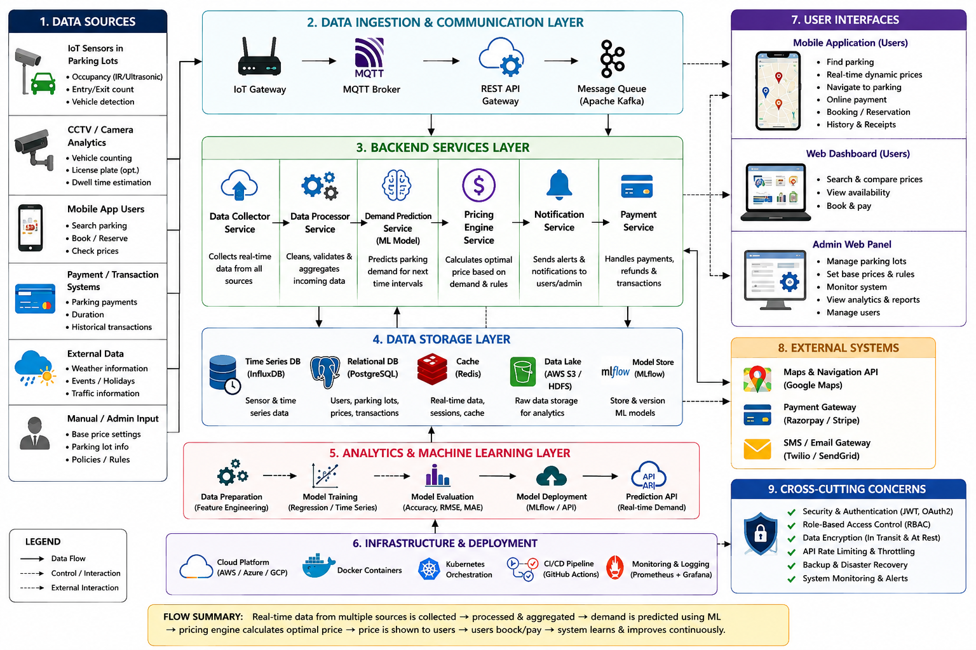
System Architecture

Slide 12
Methodology / Workflow
1
2
3
4
5
6
Data
Collection
Demand
Monitoring
Demand
Prediction
Dynamic
Pricing
User
Notification
Booking
Gather live occupancy & entry/exit data
Estimate current zone occupancy level
Forecast short-term demand trend
Recalculate price from demand tier
Push price & availability to drivers
Confirm slot and reservation
A closed-loop workflow: each booking's outcome feeds back into future demand monitoring.

Slide 13
System / Product Design
Design Overview
Sensor and app events flow into backend services that classify demand and recompute price per zone.
A relational data store holds zones, price tiers, and bookings; the pricing history feeds back into demand analysis.
User Interaction
Drivers view live availability and price on a map-style interface before selecting and booking a slot.
Simplified Data Flow
Parking
Zone
Occupancy
Event
Demand
Level
Pricing
Rule Engine
Price /
Booking DB
User
App / UI
Demand Level → Pricing Rule Engine feedback loop
UML/ER-style relationships shown are conceptual; refine with a full class/ER diagram during implementation.

Slide 14


Technology Stack & Tools
Language & Frameworks
Database & Storage
ML & Prediction
Java
Spring Boot — REST services
[Insert front-end framework]
Relational DB — [MySQL / PostgreSQL]
Cache layer for live occupancy
[Insert data lake / logs store]
[Insert ML library, e.g. scikit-learn]
Historical + real-time feature inputs
Demand classification model
IoT & Sensors
APIs & Platforms
Deployment Tools
Occupancy / entry-exit sensors
Edge gateway for local aggregation
[Insert sensor protocol]
Maps / navigation API
Payment gateway API
Notification (SMS / push) API
[Insert cloud platform]
Containerization for services
[Insert CI/CD tool]

Slide 15
Module Design
Input Layer: Parking occupancy, vehicle arrivals, historical demand, time, and location data
Processing Layer: Real-time demand analysis and prediction
Core Modules:
Demand Monitoring Module
Dynamic Pricing Engine Module
User Notification & Booking Module
Output Layer: Updated parking price, availability information, notifications, and booking confirmation
Goal: Optimize parking utilization, reduce congestion, and provide fair demand-based pricing
Flow:
Real-Time Data → Demand Prediction → Dynamic Pricing → User Notification → Parking Booking

Slide 16
Module 1:Demand Monitoring
Purpose :Continuously monitor parking demand and estimate the current occupancy level of each parking zone.
Key Functions
Collects real-time parking occupancy data
Tracks vehicle entry and exit rates
Monitors available parking spaces
Inputs
Number of occupied spaces
Number of available spaces
Arrival/departure rate
Output
Predicted Demand Level: Low / Medium / High

Slide 17
Module 2 :Dynamic Pricing Engine
Purpose : Automatically calculate parking fees according to predicted real-time demand.
Key Functions
Receives demand level from the Demand Monitoring Module
Predicts short-term parking demand
Applies predefined pricing rules
Example Pricing Logic
Demand Level | Occupancy | Pricing
Low | 0–40% | ₹20/hour
Medium | 41–70% | ₹30/hour
High | 71–100% | ₹45/hour

Slide 18
Module 3 : User Notification & Booking
Purpose : Provide users with real-time parking information and allow them to reserve available spaces.
Key Functions
Displays nearby parking locations
Shows available parking spaces
Displays current dynamic price
Sends price and availability notifications
User Interaction
Search Parking → View Availability → Check Dynamic Price → Select Slot → Book → Confirmation
Benefits
Reduces time spent searching for parking
Improves user convenience
Provides transparent pricing

Slide 19
Key Algorithm / Technical Implementation
Prediction Logic
A short-term demand model estimates the occupancy trend for each zone from recent arrival/departure rates and historical patterns.
Pricing Logic
The predicted occupancy percentage is mapped to a demand tier (Low / Medium / High), and the tier selects the active hourly rate.
PSEUDOCODE — PRICE CALCULATION
function computePrice(zone):
occupancy = zone.occupiedSpaces
/ zone.totalSpaces
if occupancy <= 0.40:
level = LOW; price = 20
else if occupancy <= 0.70:
level = MEDIUM; price = 30
else:
level = HIGH; price = 45
notify(zone, level, price)
return price

Slide 20
Prototype / Working Model
Conceptual mock UI — not an actual product screenshot
Find Parking
Operator Dashboard — Demand & Pricing View
Central Mall Parking
150
104 (69%)
MEDIUM
₹30/hr
72% full
₹30/hr
Total Spaces
Occupied
Current Demand
Active Price
City Center Parking
Notification Preview
95% full
₹45/hr
"Price at Central Mall Parking just changed to ₹30/hr — 46 spaces available."
Railway Station Parking
28% full
₹20/hr

Slide 21
Testing & Validation
Testing Strategy
Combine unit testing of the pricing engine's threshold logic with integration testing across monitoring → pricing → notification.
Experimental Setup
Simulated occupancy feeds exercise each demand tier; [Insert dataset / testbed description].
Test Case
Input Condition
Expected Result
Status
TC-01 Low demand pricing
Occupancy = 25%
Price set to ₹20/hour
Pass
TC-02 Medium demand pricing
Occupancy = 55%
Price set to ₹30/hour
Pass
TC-03 High demand pricing
Occupancy = 88%
Price set to ₹45/hour
Pass
TC-04 Notification delivery
Price change event
User notified within target latency
[Insert]
TC-05 Booking confirmation
Slot selected & paid
Booking confirmed, occupancy updated
[Insert]

Slide 22
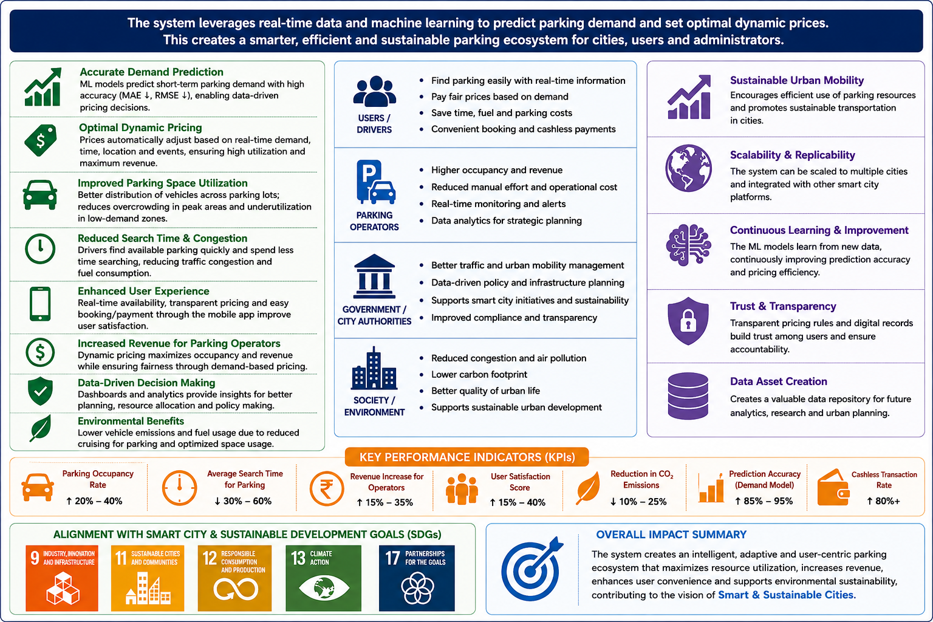
Expected Outcomes & Impact
Deliverables
Benefits
Fully functional dynamic pricing system
Trained and validated ML demand prediction model
Research paper and technical documentation
Reduced parking search time for drivers
Optimized parking revenue for city authorities
Lower vehicle emissions from reduced cruising
Future Work
Multi-city and multi-zone deployment at scale
Integration with autonomous vehicle routing systems
[Additional extensions — EV charging, public transit linkage]

Slide 23
Comparison with Existing Solutions
Capability
Fixed Pricing (Existing)
Proposed Dynamic System
Real-Time Adaptation
None — price fixed regardless of demand
Price recalculated from live occupancy
Demand Prediction
Not supported
Short-term prediction drives pricing
Parking Utilization
Uneven — some lots overflow, others idle
Redistributes demand toward underused lots
User Notifications
Not available
Live price & availability alerts
Booking Support
Manual / none
Integrated search → book → confirm flow
Scalability
Per-lot manual tariff changes
Rule-based engine scales across zones

Slide 24
Challenges & Engineering Decisions
Real-Time Data Handling
Prediction Accuracy
Challenge: Sensor feeds arrive continuously and unevenly. Decision: Buffer and aggregate readings per short interval before scoring demand.
Challenge: Short-term demand can shift quickly with events/weather. Decision: Combine historical baselines with live occupancy signals; revisit thresholds periodically.
Dynamic Pricing Decisions
System Latency
Challenge: Prices must stay fair and predictable for drivers. Decision: Use bounded, published price tiers rather than unconstrained real-time bidding.
Challenge: Delays weaken the incentive effect of pricing. Decision: Keep the pricing rule lightweight; target end-to-end latency under [Insert] seconds.
Scalability
Data Availability
Challenge: Zones and sensors will grow with deployment. Decision: Design each module (monitor / price / notify) to scale independently per zone.
Challenge: Historical parking datasets are limited early on. Decision: Start with rule-based tiers; layer in learned prediction as data accumulates.

Slide 25

Individual Contributions
D. Chand Basha
Ganeshram. M
Monish. S
Reg. No. 192424218
Reg. No. 192321060
Reg. No. 192311132
Backend module implementation (Java)
design documentation
Demand Monitoring logic
Editable — confirm exact scope with team
System architecture
Backend module implementation (Java)
User Notification & Booking
Editable — confirm exact scope with team
Backend module implementation (Java)
Pricing engine verification
Editable — confirm exact scope with team
Dynamic Pricing Engine

Slide 26
Project Progress / Milestones
Problem Study &
Literature Review
Requirements &
Architecture Design
Module Design
(1, 2, 3)
Algorithm &
Prototype Build
Testing &
Validation
Final Review &
Deployment
Completed
Completed
In Progress
In Progress
Planned
Planned
Current Status
Architecture, module design, and literature review are completed.
Module implementation and prototype work are in progress.

Slide 27
Limitations
Data Availability
Prediction Limitations
Real historical parking-demand datasets are limited during early development, so pricing tiers currently rely on assumed thresholds.
Short-term demand prediction may lose accuracy during unusual events, holidays, or extreme weather.
Deployment Limitations
Infrastructure / Cost
Full deployment requires physical sensor installation across zones, which is outside the current academic scope.
IoT hardware, cloud hosting, and API costs would scale with the number of zones covered.

Slide 28




Future Enhancements
Multi-City Deployment
Multi-Zone Scaling
Autonomous Vehicle Routing
EV Charging Integration
Public Transit Linkage
Advanced Prediction Models
Commercial Deployment
Revenue Optimization Analytics

Slide 29
Conclusion & Project Outcomes
Summary
The Dynamic Public Parking Pricing System links real-time occupancy sensing, short-term demand prediction, and automated pricing into one connected pipeline — closing a gap left open by prior standalone research.
Key Learning Outcomes
Applied Java-based backend design to a real-world smart-city problem end to end.
Practiced translating a research gap into concrete modules, requirements, and test cases.
Progress toward stated objectives (see Slide 8)
Reduced parking search time and congestion
Sustainable, data-driven smart-city contribution
A foundation ready for future enhancement

Slide 30
References
Research Papers
Ali, S. & Shah, M. (2022). IoT-Based Smart Parking Monitoring System.
Zhang, Y. et al. (2023). Machine Learning-Based Parking Demand Prediction.
Zhou, H. & Lee, K. (2023). Dynamic Parking Pricing Using Demand–Supply Analysis.
Sarker, T. et al. (2024). Smart Parking Management System with IoT Integration.
Mabrouk, A. et al. (2024). Deep Learning-Based Parking Demand Forecasting.
Technologies, APIs & Datasets
Java / Spring Boot documentation — [Insert reference version].
[Insert ML framework documentation, e.g., scikit-learn].
[Insert maps / navigation API documentation].
[Insert payment gateway API documentation].
Books & Standards
[Insert relevant textbook or IEEE/ISO standard, if used].

Slide 31
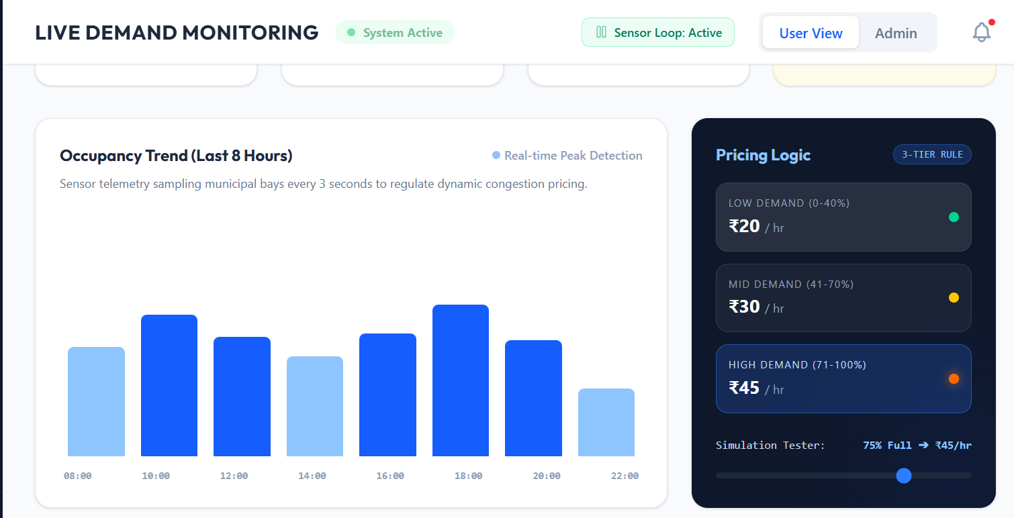
IMPLEMENTATION

Slide 32


